Slide 1

Session 4. Advanced visualisations
[60 min]

Slide 2
Session 4. Advanced visualisations
The grammar of graphics
[60 min]
[30 min]

Slide 3
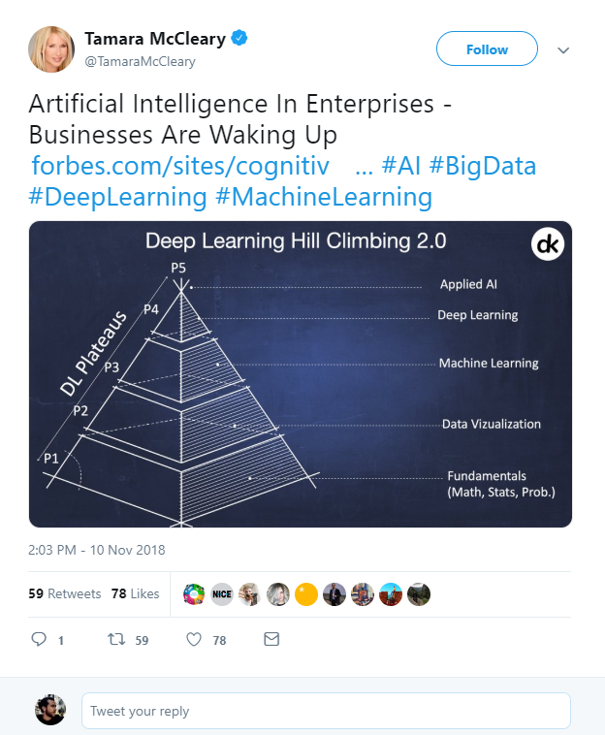

What is Data Science?
Artificial Intelligence?
Machine Learning?
Deep Learning?
Big Data?
https://twitter.com/TamaraMcCleary/status/1061197523610550272
Notes:
Tamara MCcleary – Tech Influencer
The data science pyramid
What do some of the more “fashionable” terms mean?
https://twitter.com/TamaraMcCleary/status/1061197523610550272

Slide 4


1 ZB zeta-exa-peta terra-giga-mega
Norhteastern, 2016
Notes:
In one year, humanity generates around 1ZB of data.
www.northeastern.edu/graduate/blog/how-much-data-produced-every-day/
If you take an average 10GB phone, that means 100 billion of phones.
If you take these phones and you stack them, screen to back, you could build one million 800m tall towers.
That is one Burj Khalifa for every pixel on this screen.

Slide 5
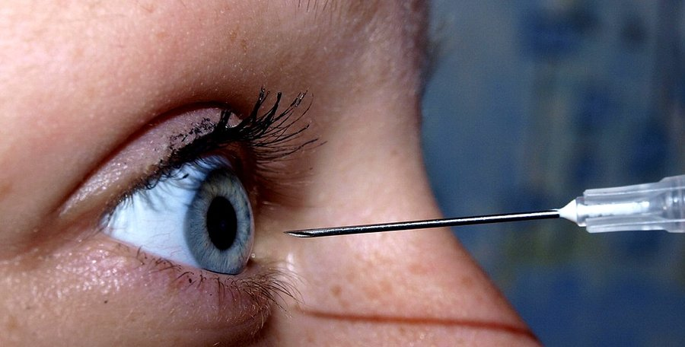
Attention ? At tension ?
Notes:
Data is practically infinite. But is your attention, too?

Slide 6

250 ms
Sabine Kastner et al., Princeton, 2018
Notes:
Sabine Kastner et al., Princeton, 2018
Your brain effectively has quarter of a second to decide what is important and what is not.

Slide 7
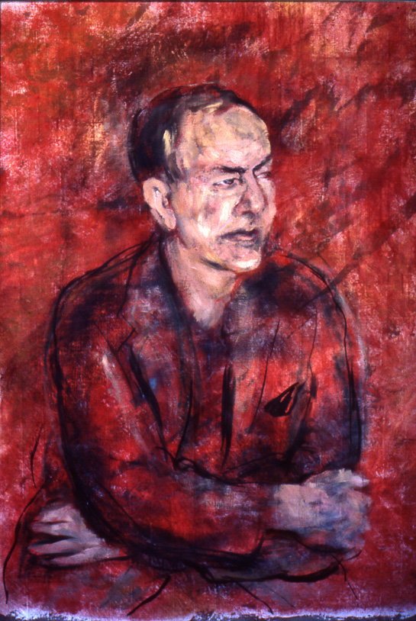
Attention poverty
"What information consumes is rather obvious: it consumes the attention of its recipients. Hence, a wealth of information creates a poverty of attention, and a need to allocate that attention efficiently among the overabundance of information sources that might consume it."
Herb Simon, as quoted by Hal Varian, Scientific American, 1995. Adapted from UW CSE442 and the original research by PARC UIR
Notes:
There is an overload of information.
We need a way to figure out what is important and what is not.

Slide 8
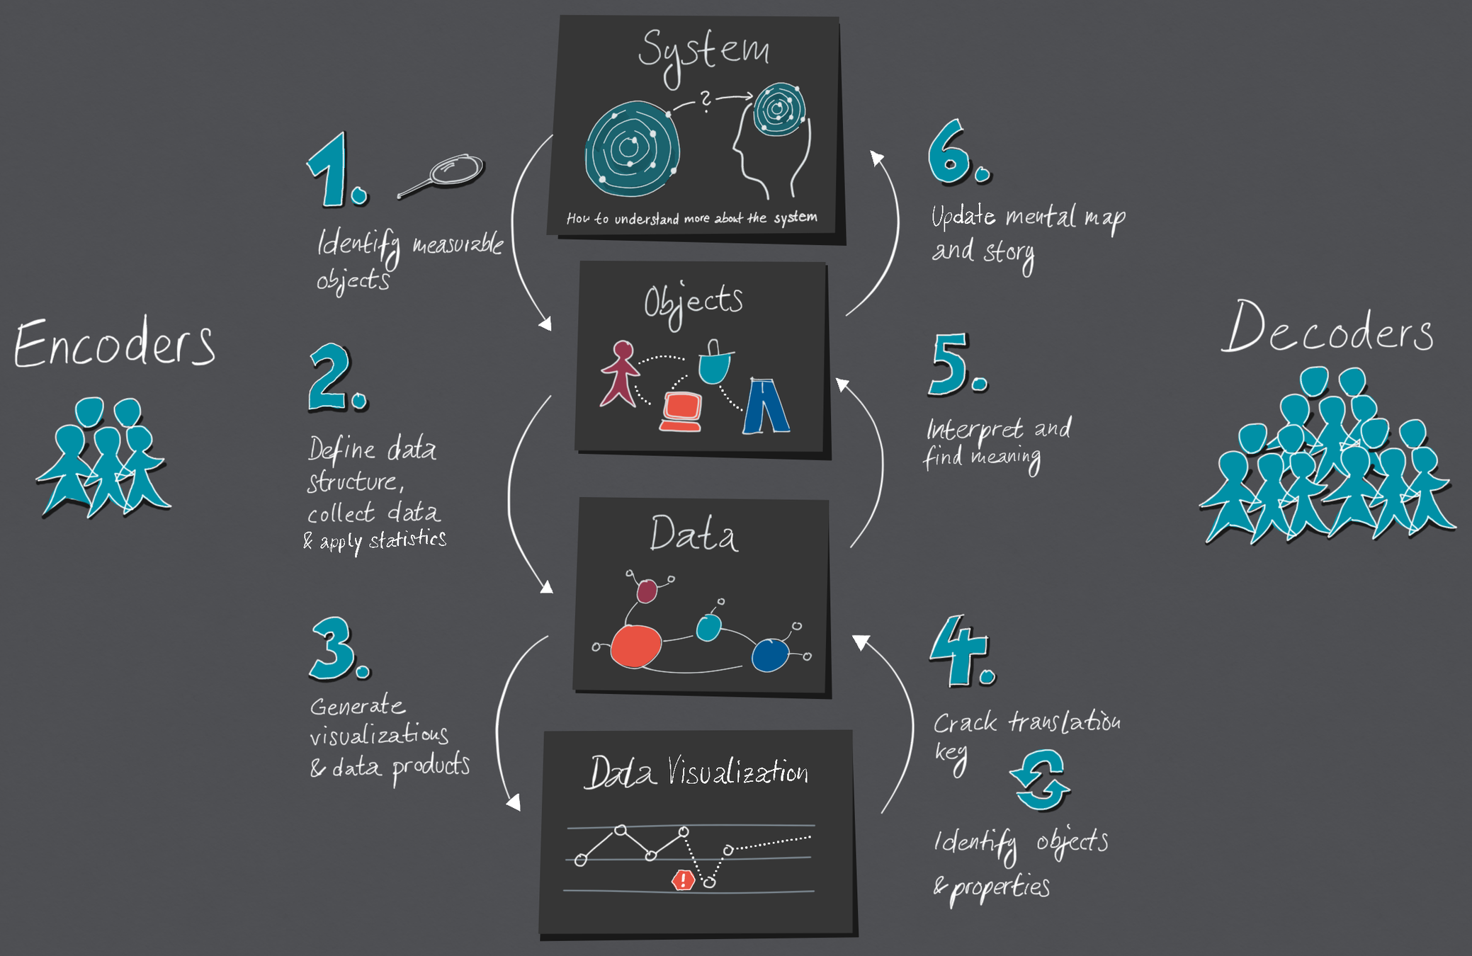

https://medium.com/nightingale/the-cycle-of-encoding-and-decoding-f3ff17010631
Notes:
Data visualisation is a language of conversing with data.
https://medium.com/nightingale/the-cycle-of-encoding-and-decoding-f3ff17010631

Slide 9

Big Data. Big Responsibility.
The Datasaurus, Autodesk, Alberto Cairo, 2017
Notes:
So there is too much data, but our attention is limited.
The art is then to extract what is important from that huge pile of data.
Welcome to Data Science.

Slide 10

Visual language is a sign system.
Images perceived as a set of signs.
Sender encodes information in signs.
Receiver decodes information from signs.
In his foreword to the 1983 English translation Howard Wainer called Bertin's work, the most important work on graphics since the publication of Playfair's Atlas
Jacques Bertin, Semiologie Graphique, 1967

Slide 11
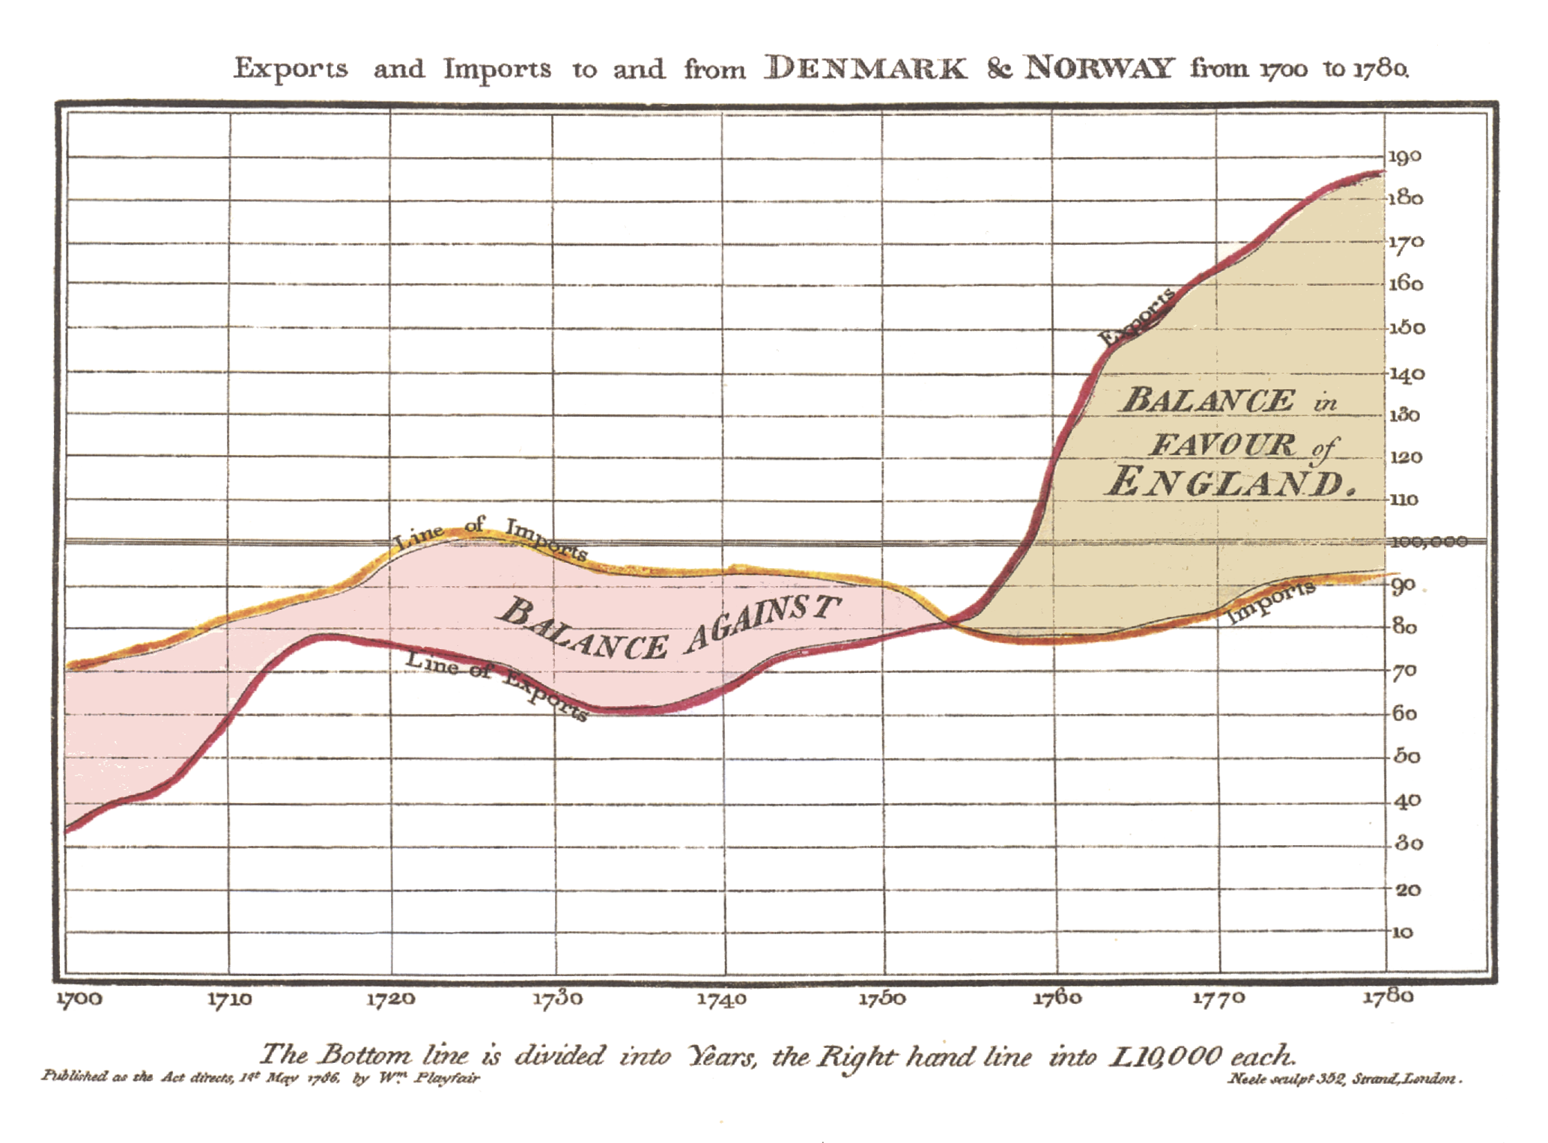
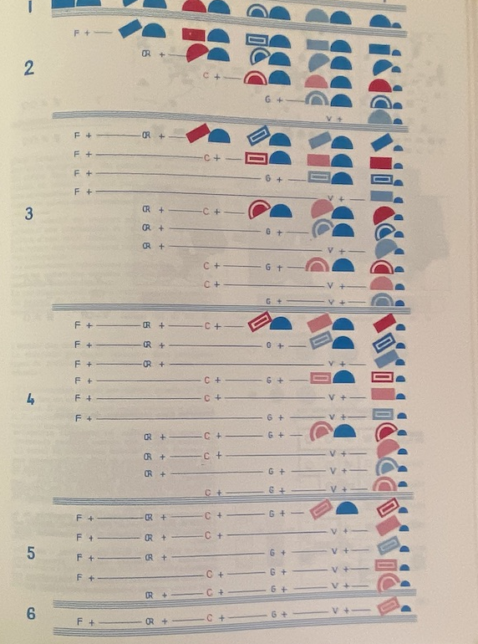
Visual language is a sign system.
William Playfair, The Commerical and Political Atlas, 1785 and Jacques Bertin, Semiologie Graphique, 1967
both collected from Jemery Norman’s HistoryOfIformation.com, 2021
Notes:
https://www.historyofinformation.com/detail.php?entryid=2929
https://www.historyofinformation.com/detail.php?id=3361

Slide 12
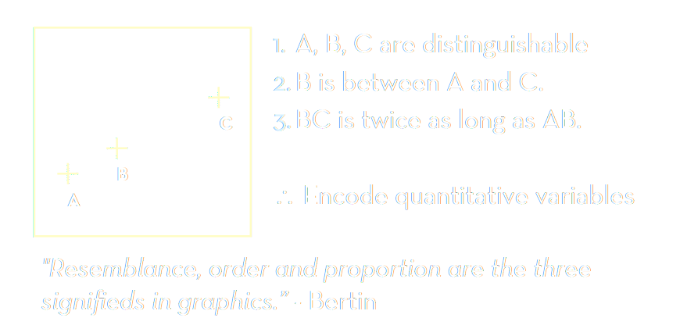
Bertin’s semiology of graphics.
Adapted from Jeffrey Heer, 2018, UW CSE442, after Jacques Bertin, Semiologie Graphique, 1967
Notes:
https://www.historyofinformation.com/detail.php?entryid=2929
https://www.historyofinformation.com/detail.php?id=3361

Slide 13
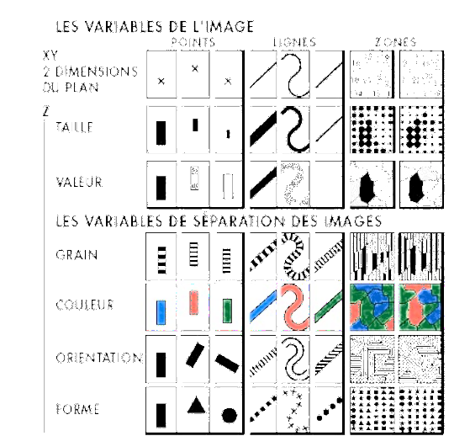
Visual encoding variables. Visual Grammar.
Position (x2)
Size
Value (Saturation)
Texture
Colour
Orientation
Shape
(Time/Animation, Focus, Opacity)
Adapted from Jeffrey Heer, 2018, UW CSE442, after Jacques Bertin, Semiologie Graphique, 1967
Notes:
https://www.historyofinformation.com/detail.php?entryid=2929
https://www.historyofinformation.com/detail.php?id=3361

Slide 14
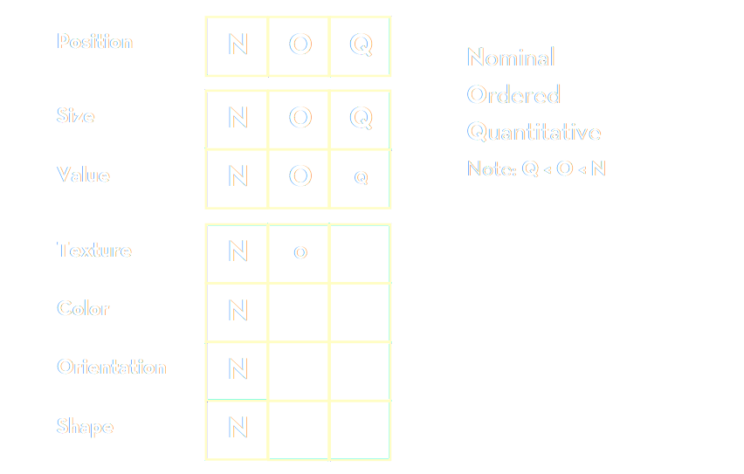
Bertin’s “Levels of Organisation”
Bertin’s list: based on theoretical considerations of semiology
Adapted from Jeffrey Heer, 2018, UW CSE442, after Jacques Bertin, Semiologie Graphique, 1967
Notes:
Bertin’s list – based on theoretical considerations of semiology

Slide 15
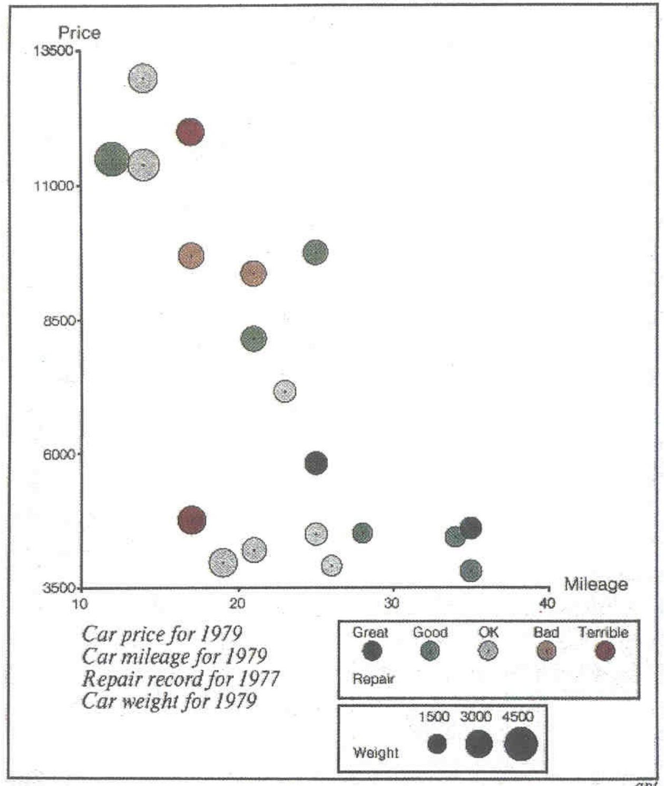
Mackinlay design criteria.
Formalizes Bertin for machines.
Expresiveness A set of facts is expressible in a visual language if the sentences (i.e. the visualisations) express all the facts in the set of data, and only the facts.
Effectiveness A visualisation is more effective than another if the information conveyed by one visualisation is more readily perceived than the information in the other visualization.
Adapted from Jeffrey Heer, 2018, UW CSE442 and Jock Mackinlay’s presentation at Ohio State University, 2005,
both based on Jock Mackinlay, Tableau/Xerox PARC/Stanford 1986
Notes:
http://web.cse.ohio-state.edu/~machiraju.1/teaching/CSE5544/mackinlay_midterm_material.pdf
Vice President of Visual Analysis at Tableau
https://www.tableau.com/learn/whitepapers/data-storytelling-using-visualization-share-human-impact-numbers

Slide 16
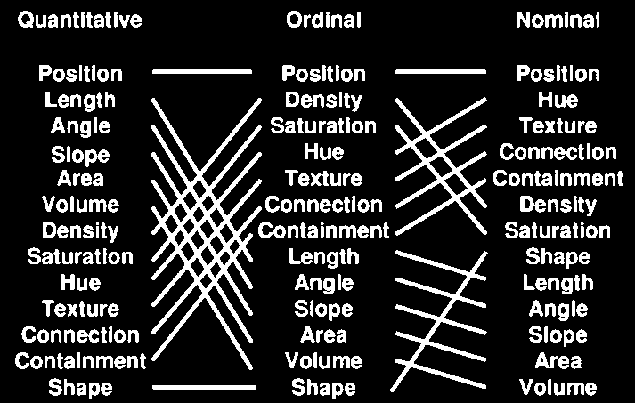
Mackinlay design criteria.
Mackinlay’s list: based on his experiments with computer graphics, trying to automate and formalize the creation of charts
The Vega visual language/grammar is built on Mackinlay’s work
Jock Mackinlay, Tableau/Xerox PARC/Stanford 1986
Notes:
Mackinlay’s list – based on his experiments with computer graphics, trying to automate and formalize the creation of charts
The first charting algorithms. The Vega visual language/grammar is built on Mackilnay’s work.

Slide 17
Which square is lighter?
Notes:
http://web.cse.ohio-state.edu/~machiraju.1/teaching/CSE5544/mackinlay_midterm_material.pdf
Vice President of Visual Analysis at Tableau
https://www.tableau.com/learn/whitepapers/data-storytelling-using-visualization-share-human-impact-numbers

Slide 18
Which square is lighter?
217, 217, 217
> 2 %
212, 212, 212
Notes:
http://web.cse.ohio-state.edu/~machiraju.1/teaching/CSE5544/mackinlay_midterm_material.pdf
Vice President of Visual Analysis at Tableau
https://www.tableau.com/learn/whitepapers/data-storytelling-using-visualization-share-human-impact-numbers

Slide 19
How many times is the right circle larger?
Notes:
http://web.cse.ohio-state.edu/~machiraju.1/teaching/CSE5544/mackinlay_midterm_material.pdf
Vice President of Visual Analysis at Tableau
https://www.tableau.com/learn/whitepapers/data-storytelling-using-visualization-share-human-impact-numbers

Slide 20
How many times is the top bar longer?
7
Notes:
http://web.cse.ohio-state.edu/~machiraju.1/teaching/CSE5544/mackinlay_midterm_material.pdf
Vice President of Visual Analysis at Tableau
https://www.tableau.com/learn/whitepapers/data-storytelling-using-visualization-share-human-impact-numbers

Slide 21
What colour do you see?
Notes:
http://web.cse.ohio-state.edu/~machiraju.1/teaching/CSE5544/mackinlay_midterm_material.pdf
Vice President of Visual Analysis at Tableau
https://www.tableau.com/learn/whitepapers/data-storytelling-using-visualization-share-human-impact-numbers

Slide 22
What colour do you see?
Notes:
http://web.cse.ohio-state.edu/~machiraju.1/teaching/CSE5544/mackinlay_midterm_material.pdf
Vice President of Visual Analysis at Tableau
https://www.tableau.com/learn/whitepapers/data-storytelling-using-visualization-share-human-impact-numbers

Slide 23
What colour do you see?
Notes:
http://web.cse.ohio-state.edu/~machiraju.1/teaching/CSE5544/mackinlay_midterm_material.pdf
Vice President of Visual Analysis at Tableau
https://www.tableau.com/learn/whitepapers/data-storytelling-using-visualization-share-human-impact-numbers

Slide 24

Stevens’ power law.
length
taste
weight
shock
sensation = intensity^{exponent}
Our senses are not linear!
area
volume
loudness
sensation →
intensity →
Stanley Smith Stevens, Harvard, 1957
Notes:
http://web.cse.ohio-state.edu/~machiraju.1/teaching/CSE5544/mackinlay_midterm_material.pdf
Vice President of Visual Analysis at Tableau
https://www.tableau.com/learn/whitepapers/data-storytelling-using-visualization-share-human-impact-numbers

Slide 25
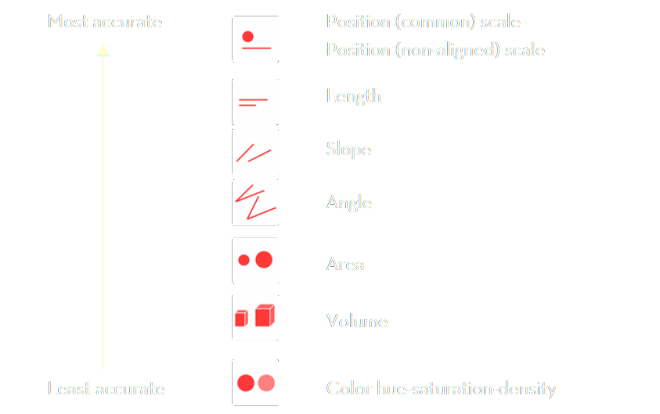
Stevens’ power law.
Stevens’ list: based on psychological experiments with human senses
Stanley Smith Stevens, Harvard, 1957

Slide 26
Visual language is a sign system.
When designing visual information use correct encodings
data → information correct data model
information → knowledge correct visual representation
Bertin’s semiology of graphics
Mackinlay design criteria
Stevens’ power law

Slide 27
Data visualization zoo.
The actual “A Tour through the Visualisation Zoo”
Economics Observatory 🌌 Visualisation Guidelines
Financial Times Visual Vocabulary
Vega Edition of the Visual Vocabulary
The D3 Graph Gallery
Andy Kirks's The Chartmaker Directory
Heer, Bostock, Ogievetsky, A Tour through the Visualization Zoo, ACM, 2010
Notes:
https://homes.cs.washington.edu/~jheer/files/zoo/

Slide 28
Session 4. Advanced visualisations
Data models
[60 min]
[30 min]

Slide 29
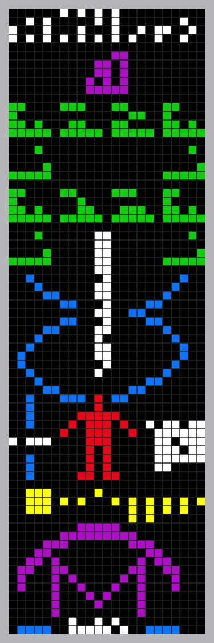

Data. Information. Knowledge.
Notes:
Arecibo message. This is data science. Find what’s important in a sea of data. That’s useful information. Put that information into context. That is knowledge.
In David McCandless’ book, Knowledge is Beautiful, something similar is the inner cover photo.
In this particular course, we will be dealing with the part of data science that you might call “Business Inteligence”.
This is exactly the Data->Information->Knowledge process.
https://www.datapine.com/blog/business-intelligence-for-small-business/

Slide 30
https://medium.com/nightingale/the-cycle-of-encoding-and-decoding-f3ff17010631
Notes:
Data visualisation is a language of conversing with data.
https://medium.com/nightingale/the-cycle-of-encoding-and-decoding-f3ff17010631
You need to correctly learn how to speak the language of data. With everything it start with understanding WHAT are you trying to say.
In the data sceince language, The DATA is the WHAT – the visualisation is the HOW.

Slide 31
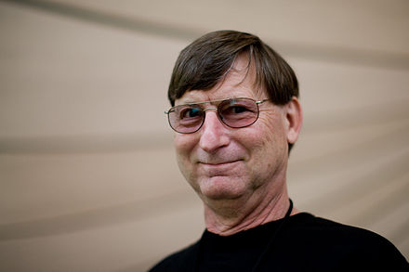
visualisation = understanding
"The ability to take data - to be able to understand it, to process it, to extract value from it, to visualize it, to communicate it - that's going to be a hugely important skill in the next decades, ...because now we really do have essentially free and ubiquitous data."
Hal Varian, Chief Economist, Google. The McKinsey Quarterly, 2009. Adapted from UW CSE442.
Notes:
There is an overload of information.
We need a way to figure out what is important and what is not.

Slide 32
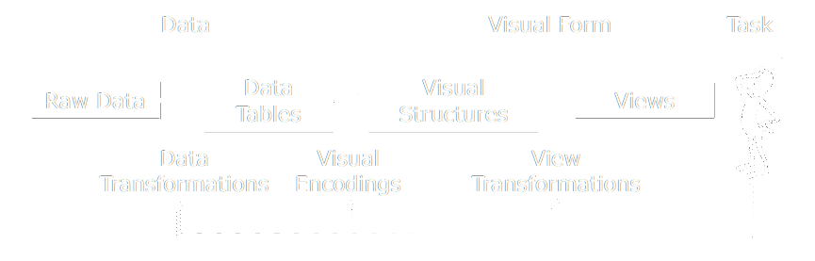
visualisation reference model
Jeffrey Heer, 2018. Adapted from UW CSE442.
Notes:
There is an overload of information.
We need a way to figure out what is important and what is not.

Slide 33
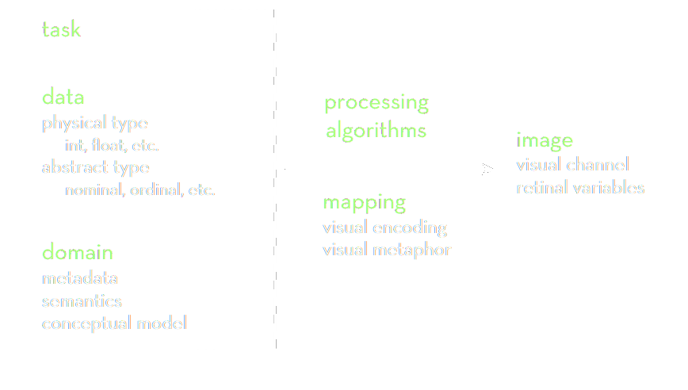
data → visualisation process
Jeffrey Heer, 2018. Adapted from UW CSE442.
Notes:
There is an overload of information.
We need a way to figure out what is important and what is not.

Slide 34
data domain.
Notes:
Open-floor question on what IS data science?

Slide 35
data models | conceptual models
Data models are a low-level description of the data.
Math: sets with operations on them ( + / · ). How many? / What kind?
Conceptual models are higher level mental abstractions.
Semantics and support reasoning. What does is mean/describe?
Examples:
1D float vs Temperature
3D float vs Space
Jeffrey Heer, 2018. Adapted from UW CSE442.
Notes:
Data model machine language

Slide 36
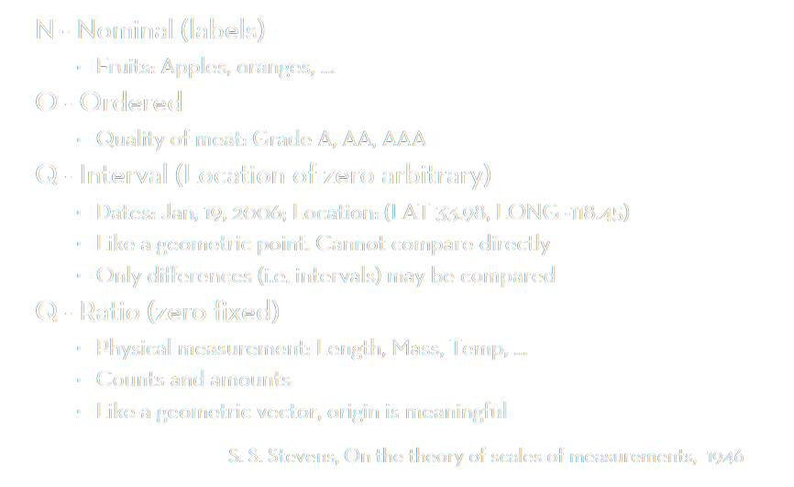
data types
O/Q
(T)
Notes:
Data model machine language

Slide 37
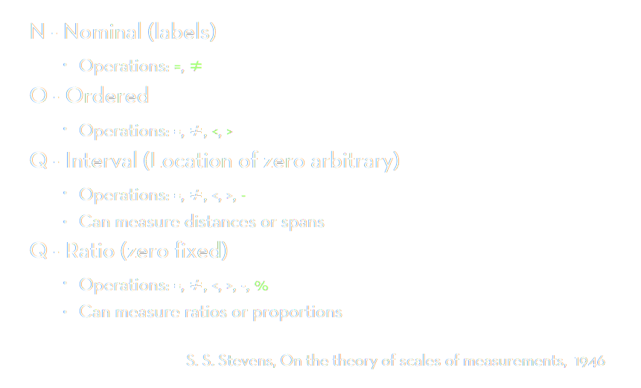
data types
O/Q
(T)
Notes:
Data model machine language

Slide 38
from model to type
Data model 12.3, red, A, 2021-10-111
Conceptual model temperature, colour, candidate ID, date
Working together:
Putting the data into the correct context → correct data type
Watch out for data traps!
“B” can be nominal or ordinal
“February” can be nominal or ordinal (special case of temporal)
“2021” can be anything

Slide 39
data → visualisation process
Jeffrey Heer, 2018. Adapted from UW CSE442.
Notes:
There is an overload of information.
We need a way to figure out what is important and what is not.

Slide 40
data wrangling.
Notes:
Open-floor question on what IS data science?

Slide 41

data standards
Economics Observatory 📐 Data Guidelines ↗
We strive to maintain all data displayed on the site in a standardized, TIDY format. That means that every data point is a row (line) and every data feature is a column. The first column is called the index, and it is the typcially the column, based on which each of the data points gets a unique identifier. Sometimes the index column of datasets is a date, in which case we can treat the the data series as time series.
Economics Observatory 🌌 Visualisation Guidelines ↗
Dénes Csala, Economics Observatory, 2021, based on Hadley Wickham, RStudio, 2012
Notes:
Data model machine language

Slide 42
TIDY data
this (wide form)
should be converted to this (long form)
Country | 2019 | 2020 | 2021
Austria | 42 | 13 | 69
Belgium | 75 | 12 | 77
Country | Year | Value
Austria | 2019 | 42
Austria | 2020 | 13
Austria | 2021 | 69
Belgium | 2019 | 75
Belgium | 2020 | 12
Belgium | 2021 | 77
Notes:
Data model machine language

Slide 43
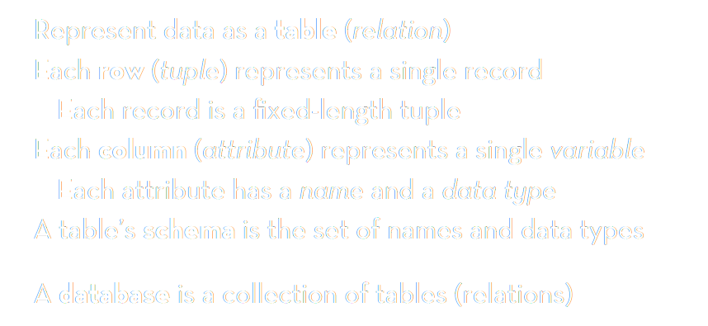
TIDY data
pandas: DataFrame
JavaScript: Object Array
Jeffrey Heer, 2018. Adapted from UW CSE442.
Notes:
There is an overload of information.
We need a way to figure out what is important and what is not.

Slide 44
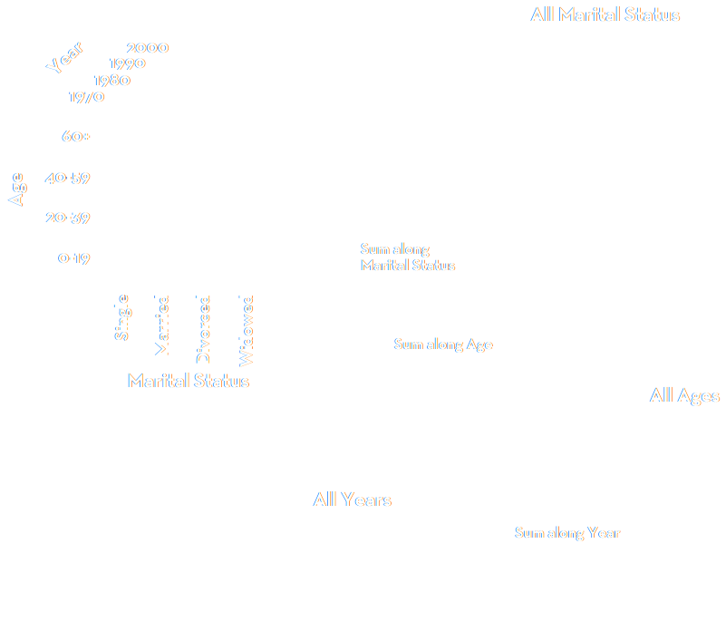
slice or dice
Jeffrey Heer, 2018. Adapted from UW CSE442.
Notes:
There is an overload of information.
We need a way to figure out what is important and what is not.

